Slide 1
Ngrams
Lecture # 4
5 February 2018

Slide 2
What is a word?
A sequence of characters demarcated by white space
Not exactly
  Spoken language
  Chinese
  It’s → it is
  Other issues in tokenization (e.g., New York, rock ‘n’ roll)

Slide 3
Types versus Tokens
A text will contain various words
Some of these words may occur more than once
“Chapter 2 introduced the regular expression, showing for example how a single search string could help a web search engine find both woodchuck and woodchucks.”
sentence contains: 25 words

Slide 4
Types versus Tokens
A text will contain various words
Some of these words may occur more than once
“Chapter 2 introduced the regular expression, showing for example how a single search string could help a web search engine find both woodchuck and woodchucks.”
25 words (tokens)
Some words (types) occur more than once (each a different token)
  a – 2
  search – 2

Slide 5
Types versus Tokens
Word Token: an occurrence of a word at a particular spatio-temporal location (e.g., a sequential position in a text, an utterance event at a time and space).
Word Type: a more abstract notion also termed lexeme – we speak of two tokens belonging to the same type.
Also, woodchuck and woodchucks are two grammatical forms of the same lexeme (woodchuck).

Slide 6
Lexicon
Used in NLP systems to associate information with words (either for parsing or generation)
Information about a word is called a lexical entry
In parsing, each word in the input is scanned, and then lexical lookup retrieves one or more entries from the lexicon. Some of the information may be dynamically computed (e.g., by exploiting various lexical regularities).
NLP-specific lexicons are similar to, but typically richer than, a printed dictionary
Some NLP systems have used machine-readable versions of printed dictionaries
Good source of links: http://www.clres.com/siglex.html

Slide 7
Words
Words provide context
  Looking at the frequent words can provide us theme/topic/understanding of the corpus that is being analyzed

Slide 8
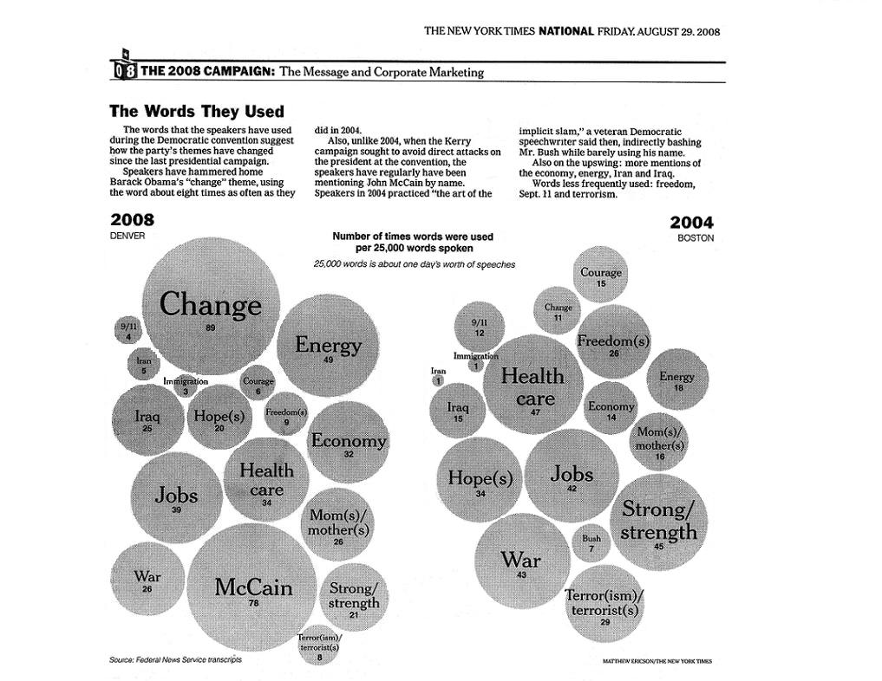

Slide 9
So words are important
the frequency … or probability … of a word can provide use information

Slide 10
Word Prediction
From a NY Times story...
  Stocks ...
  Stocks plunged this ….
  Stocks plunged this morning, despite a cut in interest rates
  Stocks plunged this morning, despite a cut in interest rates by the Federal Reserve, as Wall ...
  Stocks plunged this morning, despite a cut in interest rates by the Federal Reserve, as Wall Street began

Slide 11
  Stocks plunged this morning, despite a cut in interest rates by the Federal Reserve, as Wall Street began trading for the first time since last …
  Stocks plunged this morning, despite a cut in interest rates by the Federal Reserve, as Wall Street began trading for the first time since last Tuesday's terrorist attacks.

Slide 12
Human Word Prediction
Clearly, at least some of us have the ability to predict future words in an utterance.
How?
  Domain knowledge: red blood vs. red hat
  Syntactic knowledge: the…<adj|noun>
  Lexical knowledge: baked <potato vs. steak>

Slide 13
Claim
A useful part of the knowledge needed to allow Word Prediction can be captured using simple statistical techniques
In particular, we'll be interested in the notion of the probability of a sequence (of letters, words,…)

Slide 14
Useful Applications
Why do we want to predict a word, given some preceding words?
  Rank the likelihood of sequences containing various alternative hypotheses, e.g. for Speech Recognition
  Theatre owners say popcorn/unicorn sales have doubled...
  Assess the likelihood/goodness of a sentence, e.g. for text generation or machine translation
  The doctor recommended a cat scan.
  Der Arzt empfahl eine Katze Scan.

Slide 15
Useful Applications
Why do we want to predict a word, given some preceding words?
  Rank the likelihood of sequences containing various alternative hypotheses, e.g. for Speech Recognition
  Theatre owners say popcorn/unicorn sales have doubled...
  Assess the likelihood/goodness of a sentence, e.g. for text generation or machine translation
  The doctor recommended a cat scan.
  Der Arzt empfahl eine Katze Scan.

Slide 16
Useful Applications
Why do we want to predict a word, given some preceding words?
  Rank the likelihood of sequences containing various alternative hypotheses, e.g. for Speech Recognition
  Theatre owners say popcorn/unicorn sales have doubled...
  Assess the likelihood/goodness of a sentence, e.g. for text generation or machine translation
  The doctor recommended a cat scan.
  Der Arzt empfahl eine die Computertomographie.

Slide 17
N-Gram Models
We formalize this concept of word prediction using probabilistic language models:
  Refer to as N-gram models

Slide 18
N-gram
N refers to the number of words in the sequence
  Unigram (sequence of 1 word)
  Bigram (sequence of 2 words)
  Trigram (sequence of 3 words)
  4-gram (sequence of 4 words)
  5-gram (sequence of 5 words)
  etc….

Slide 19
Example
this is an unoriginal example utterance
What are the {1 2 and 3}-grams?

Slide 20
Example
this is an unoriginal example utterance
Unigrams:
this
is
an
unoriginal
example
utterance
Bigrams:
this is
is an
an unoriginal
unoriginal example
example utterance
Trigrams:
this is an
is an unoriginal
an unoriginal example
unoriginal example utterance

Slide 21
N-Gram Models of Language
Use the previous N-1 words in a sequence to predict the next word
Language Model (LM)
  unigrams, bigrams, trigrams,…
How do we train these models?
  Very large corpora

Slide 22
N-gram Modeling
Assume a language has T word types in its lexicon,
and what we are predicting is
how likely is word x to follow word y?

Slide 23
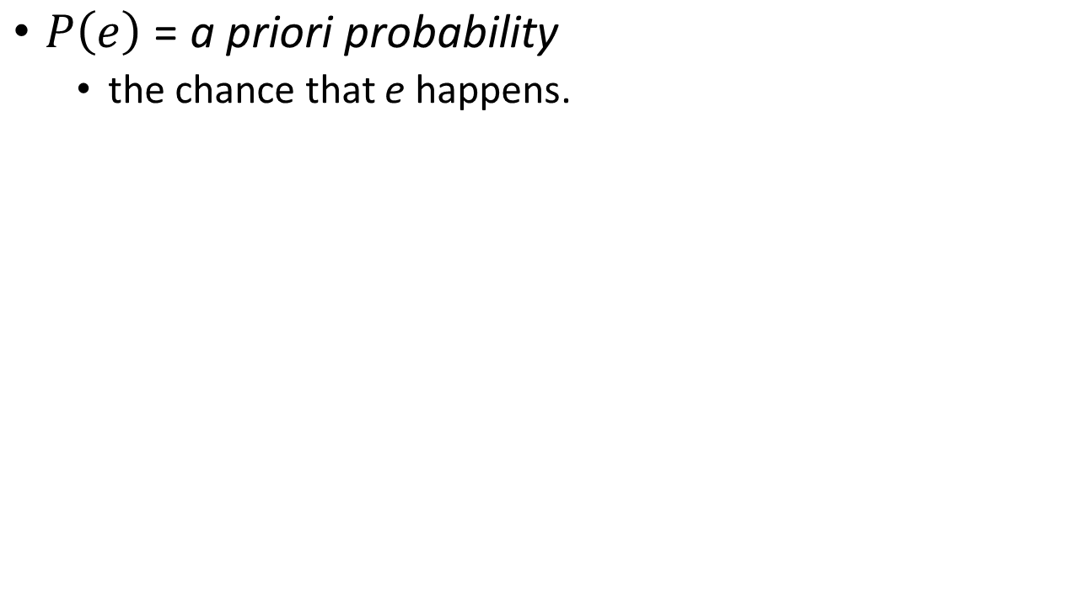
Basic Probability

Slide 24
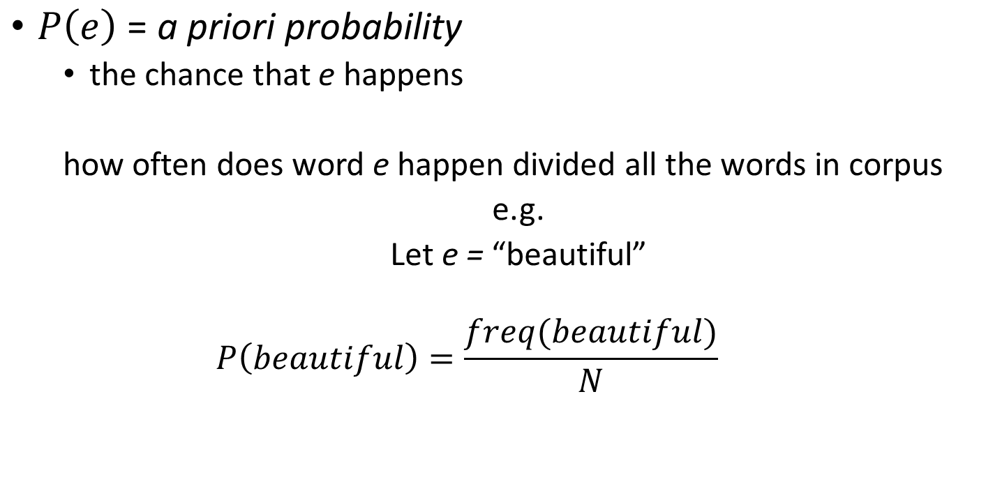
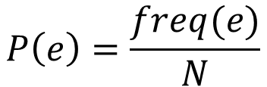
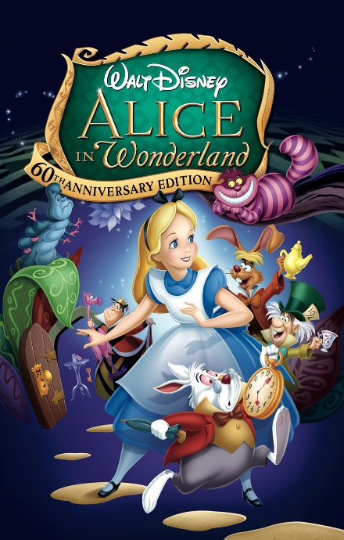
Basic Probability

Slide 25
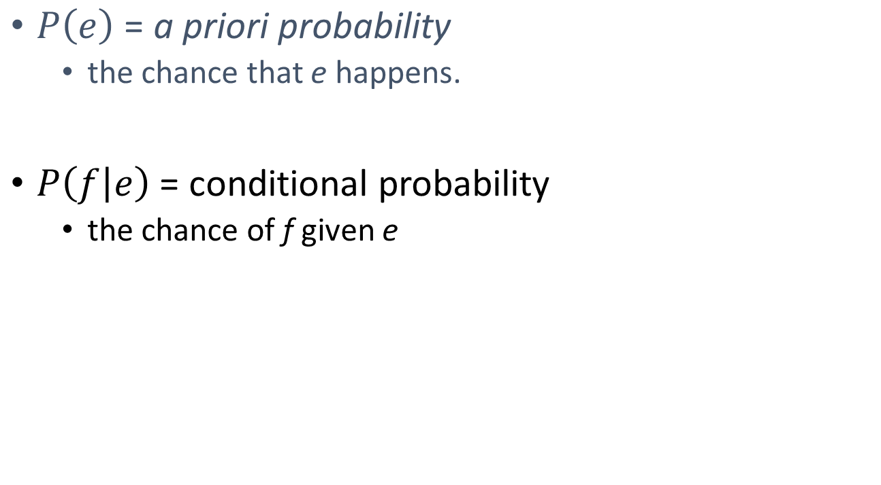
Basic Probability

Slide 26
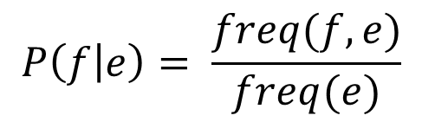
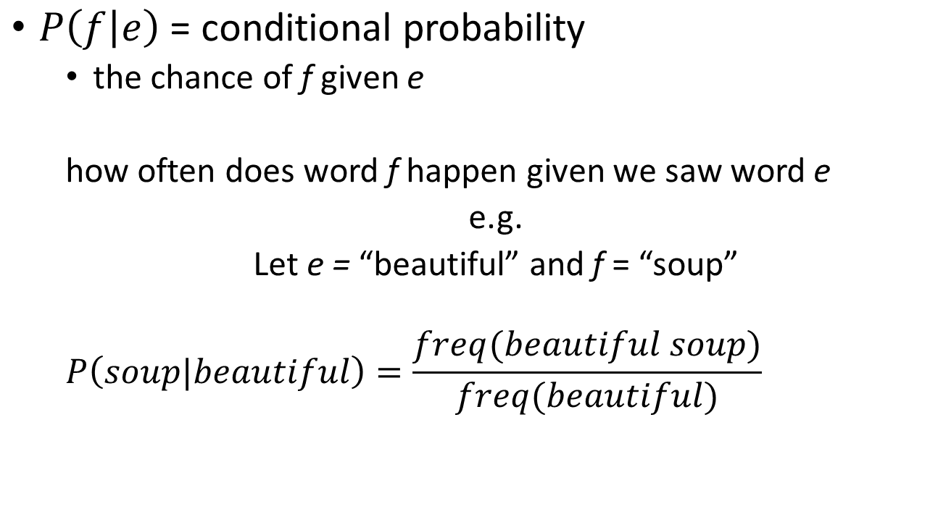

Basic Probability

Slide 27
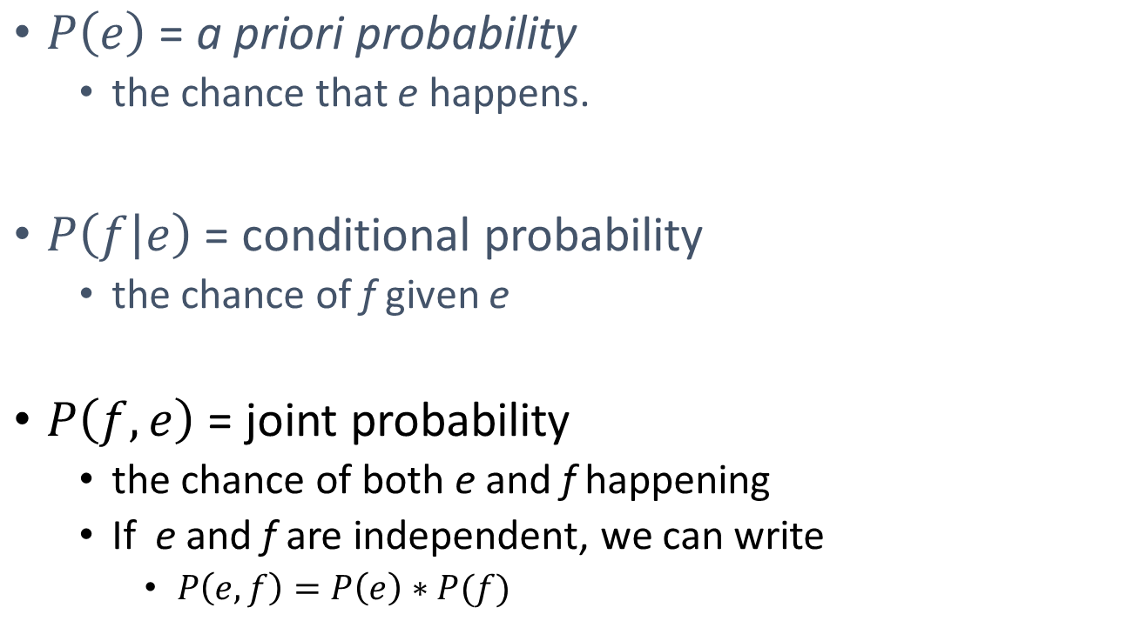
Basic Probability

Slide 28
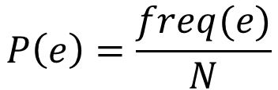
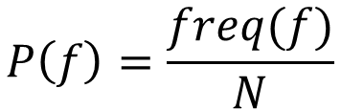
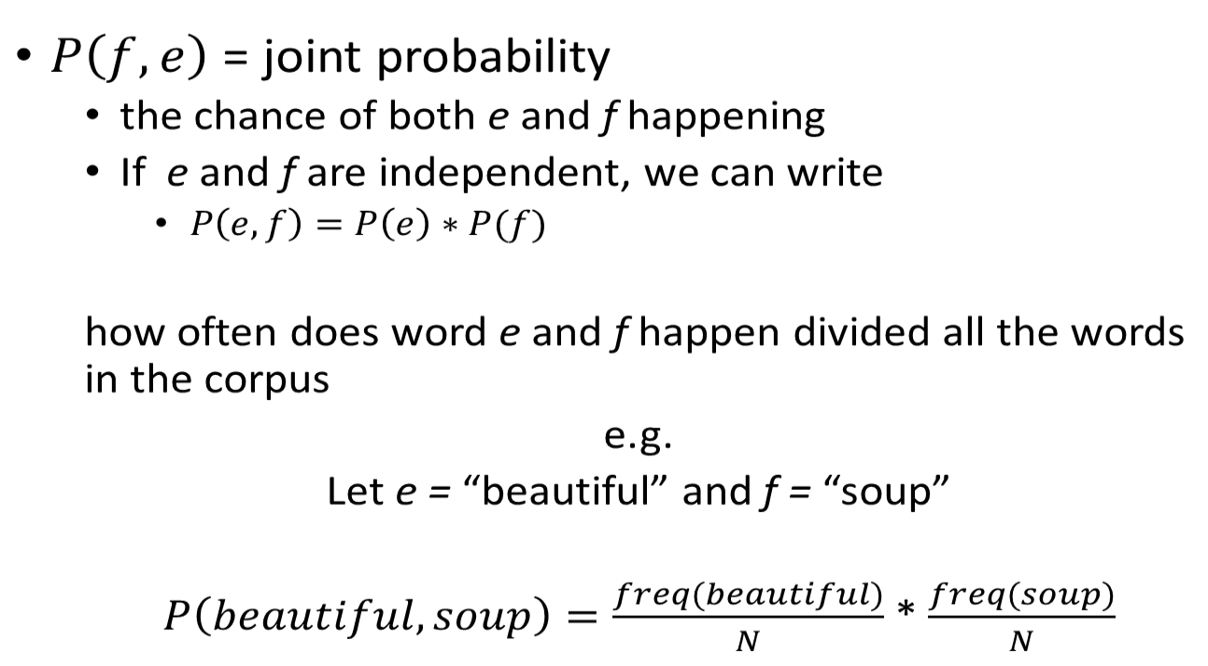

Basic Probability

Slide 29
N-gram Modeling
Assume a language has T word types in its lexicon,
and what we are predicting is
how likely is word x to follow word y?
  Theatre owners say popcorn|unicorn sales have doubled.
  what is the probability that x = unicorn versus x = popcorn?
  Simplest model of word probability: 1/T
    This assumes that any word in the language has the same probability of occurring as any other
    P(unicorn) = P(popcorn)

Slide 30
Simple N-Grams
Assume a language has T word types in its lexicon, how likely is word x to follow word y?
  Theatre owners say popcorn/unicorn sales have doubled.
  Alternative 1: estimate likelihood of x occurring based on its general frequency of occurrence estimated from a corpus
  (unigram probability)
Corpus
N = 1000
----------------
popcorn 10
unicorn 1
P(popcorn) = 10/1000
P(unicorn) = 1/1000
    popcorn is more likely to occur than unicorn

Slide 31
Simple N-Grams
Assume a language has T word types in its lexicon, how likely is word x to follow word y?
  Theatre owners say popcorn/unicorn sales have doubled.
  Alternative 2: condition the likelihood of x occurring in the context of previous words
    what is more likely
    Theater owners say unicorn ➔ P(unicorn|Theater owners say)
    or
    Theater owners say popcorn ➔ P(popcorn|Theater owners say)

Slide 32
This works okay with shorter sentences
  P(the mythical unicorn)
But…the longer the sequence, the less likely we are to find it in a training corpus
P(Most biologists and folklore specialists
believe that in fact the mythical unicorn
horns derived from the narwhal) = ?

Slide 33
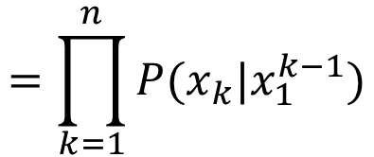
Enter : Chain Rule
Chain rule: allows us to decompose the probability into a product of component conditional probabilities
  P(the mythical unicorn) = P(the) * P(mythical|the) * P(unicorn|the mythical)

Slide 34
Enter : Chain Rule
Chain rule: allows us to decompose the probability into a product of component conditional probabilities
  P(the mythical unicorn) = P(the) * P(mythical|the) * P(unicorn|the mythical)
Although, we still have the problem that the longer the sequence, the less likely we are to find it in a training corpus
    P(Most biologists and folklore specialists believe that in fact the mythical unicorn horns derived from the narwhal)

Slide 35
Problem
    P(Most biologists and folklore specialists believe that in fact the mythical unicorn horns derived from the narwhal)
    P(Most) *
    P(biologists|most) *
    P(and |most biologists) *
    P(folklore|Most biologists and) *
    P(specialist|Most biologists and folklore) *
    …
    P(narwhal|Most biologists and folklore specialists believe that in fact the mythical unicorn horns derived from the)

Slide 36
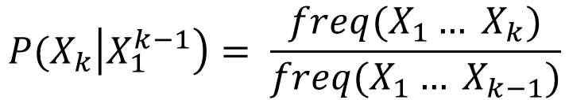
Tough to find the sequence in text
    P(narwhal|Most biologists and folklore specialists believe that in fact the mythical unicorn horns derived from the ) =
      Freq(Most biologists and folklore specialists believe that in fact the mythical unicorn horns derived from the narwhal)
      Freq(Most biologists and folklore specialists believe that in fact the mythical unicorn horns derived from the)

Slide 37
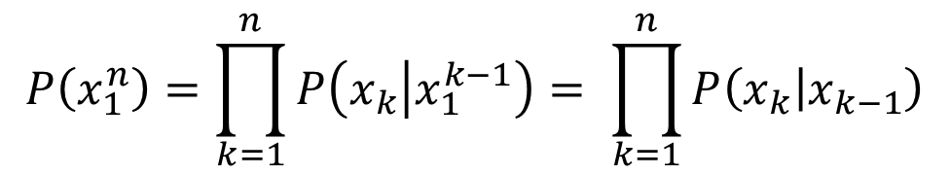
Enter : Markov Assummption:
Markov Assumption: word is only dependent on its limit history
This allows us only go back k-1 words
  Estimate: P(unicorn|the mythical) using (unicorn|mythical)

Slide 38
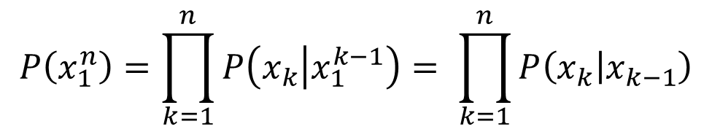
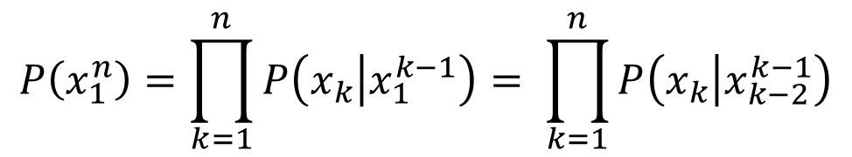
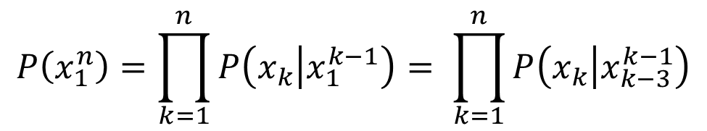
N-gram Model
Bigram:
Trigram:
4-gram:

Slide 39
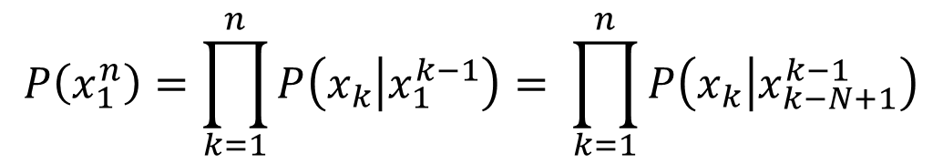
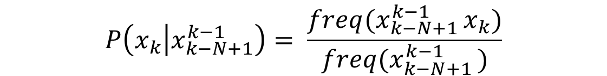
Relative Frequency

Slide 40
Relative Frequency
this ratio is called relative frequency

Slide 41
Example

Slide 42
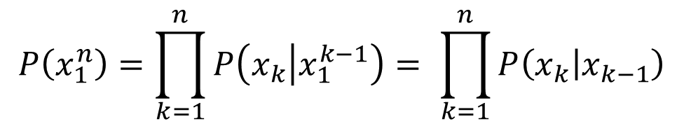
Relative Frequency Example
I want to eat Chinese Food.
using the bigram model

Slide 43
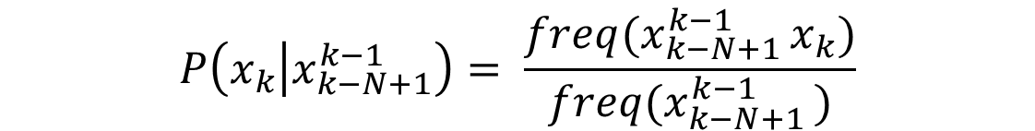
Example
I want to eat Chinese Food.

Slide 44
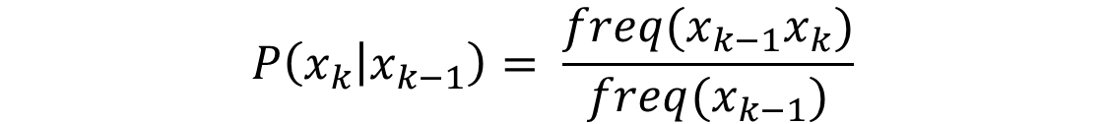
Example
I want to eat Chinese Food.
What information do we need?
Where do we get it from?

Slide 45
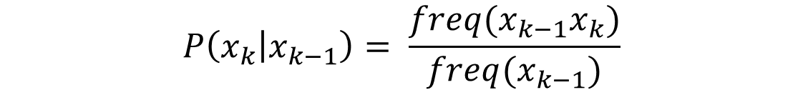
Corpus
Bigram table of raw frequency’s
 | i | want | to | eat | chinese | food | lunch | spend | <start> | <end>
i | 5 | 827 | 0 | 9 | 0 | 0 | 0 | 2 | 0 | 0
want | 2 | 0 | 608 | 1 | 6 | 6 | 5 | 1 | 0 | 0
to | 2 | 0 | 4 | 686 | 2 | 0 | 6 | 211 | 0 | 0
eat | 0 | 0 | 2 | 0 | 16 | 2 | 42 | 0 | 0 | 34
chinese | 1 | 0 | 0 | 0 | 0 | 82 | 1 | 0 | 0 | 23
food | 15 | 0 | 15 | 0 | 1 | 1 | 0 | 0 | 0 | 12
lunch | 2 | 0 | 0 | 0 | 0 | 0 | 0 | 0 | 0 | 9
spend | 1 | 0 | 1 | 0 | 0 | 0 | 0 | 0 | 1 | 17
<start> | 45 | 0 | 30 | 0 | 15 | 10 | 3 | 0 | 0 | 0
<end> | 0 | 0 | 0 | 0 | 3 | 23 | 6 | 34 | 0 | 0

Slide 46
Corpus
i | want | to | eat | chinese | food | lunch | spend | <start> | <end>
2533 | 927 | 2417 | 746 | 158 | 1093 | 341 | 278 | 3000 | 3000
Unigram table of raw frequency’s
Bigram table of raw frequency’s
 | i | want | to | eat | chinese | food | lunch | spend | <start> | <end>
i | 5 | 827 | 0 | 9 | 0 | 0 | 0 | 2 | 0 | 0
want | 2 | 0 | 608 | 1 | 6 | 6 | 5 | 1 | 0 | 0
to | 2 | 0 | 4 | 686 | 2 | 0 | 6 | 211 | 0 | 0
eat | 0 | 0 | 2 | 0 | 16 | 2 | 42 | 0 | 0 | 34
chinese | 1 | 0 | 0 | 0 | 0 | 82 | 1 | 0 | 0 | 23
food | 15 | 0 | 15 | 0 | 1 | 1 | 0 | 0 | 0 | 12
lunch | 2 | 0 | 0 | 0 | 0 | 0 | 0 | 0 | 0 | 9
spend | 1 | 0 | 1 | 0 | 0 | 0 | 0 | 0 | 1 | 17
<start> | 45 | 0 | 30 | 0 | 15 | 10 | 3 | 0 | 0 | 0
<end> | 0 | 0 | 0 | 0 | 3 | 23 | 6 | 34 | 0 | 0

Slide 47
 | i | want | to | eat | chinese | food | lunch | spend | <start> | <end>
i | 5 | 827 | 0 | 9 | 0 | 0 | 0 | 2 | 0 | 0
want | 2 | 0 | 608 | 1 | 6 | 6 | 5 | 1 | 0 | 0
to | 2 | 0 | 4 | 686 | 2 | 0 | 6 | 211 | 0 | 0
eat | 0 | 0 | 2 | 0 | 16 | 2 | 42 | 0 | 0 | 34
chinese | 1 | 0 | 0 | 0 | 0 | 82 | 1 | 0 | 0 | 23
food | 15 | 0 | 15 | 0 | 1 | 1 | 0 | 0 | 0 | 12
lunch | 2 | 0 | 0 | 0 | 0 | 0 | 0 | 0 | 0 | 9
spend | 1 | 0 | 1 | 0 | 0 | 0 | 0 | 0 | 1 | 17
<start> | 45 | 0 | 30 | 0 | 15 | 10 | 3 | 0 | 0 | 0
<end> | 0 | 0 | 0 | 0 | 3 | 23 | 6 | 34 | 0 | 0
I | want | to | eat | chinese | food | lunch | spend | <start> | <end>
2533 | 927 | 2417 | 746 | 158 | 1093 | 341 | 278 | 3000 | 3000

Slide 48
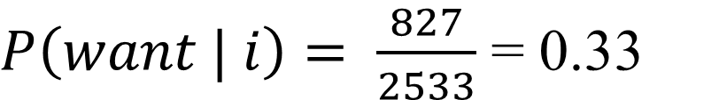
 | i | want | to | eat | chinese | food | lunch | spend | <start> | <end>
i | 5 | 827 | 0 | 9 | 0 | 0 | 0 | 2 | 0 | 0
want | 2 | 0 | 608 | 1 | 6 | 6 | 5 | 1 | 0 | 0
to | 2 | 0 | 4 | 686 | 2 | 0 | 6 | 211 | 0 | 0
eat | 0 | 0 | 2 | 0 | 16 | 2 | 42 | 0 | 0 | 34
chinese | 1 | 0 | 0 | 0 | 0 | 82 | 1 | 0 | 0 | 23
food | 15 | 0 | 15 | 0 | 1 | 1 | 0 | 0 | 0 | 12
lunch | 2 | 0 | 0 | 0 | 0 | 0 | 0 | 0 | 0 | 9
spend | 1 | 0 | 1 | 0 | 0 | 0 | 0 | 0 | 1 | 17
<start> | 45 | 0 | 30 | 0 | 15 | 10 | 3 | 0 | 0 | 0
<end> | 0 | 0 | 0 | 0 | 3 | 23 | 6 | 34 | 0 | 0
I | want | to | eat | chinese | food | lunch | spend | <start> | <end>
2533 | 927 | 2417 | 746 | 158 | 1093 | 341 | 278 | 3000 | 3000

Slide 49
 | i | want | to | eat | chinese | food | lunch | spend | <start> | <end>
i | 0.002 | 0.33 | 0 | 0.0036 | 0 | 0 | 0 | 0.00079 | 0 | 0
want | 0.0022 | 0 | 0.66 | 0.0011 | 0.0065 | 0.0065 | 0.0064 | 0.0011 | 0 | 0
to | 0.00083 | 0 | 0.0017 | 0.28 | 0.00083 | 0 | 0.0025 | 0.087 | 0 | 0
eat | 0 | 0 | 0.0027 | 0 | 0.021 | 0.0027 | 0.056 | 0 | 0 | 0.011
chinese | 0.0063 | 0 | 0 | 0 | 0 | 0.52 | 0.0063 | 0 | 0 | 0.008
food | 0.014 | 0 | 0.014 | 0 | 0.00092 | 0.0037 | 0 | 0 | 0 | 0.004
lunch | 0.0059 | 0 | 0 | 0 | 0 | 0.0029 | 0 | 0 | 0 | 0.003
spend | 0.0036 | 0 | 0.0036 | 0 | 0 | 0 | 0 | 0 | 1 | 0.006
<start> | 0.015 | 0 | 0.01 | 0 | 0.005 | 0.003 | 0.001 | 0 | 0 | 0
<end> | 0 | 0 | 0 | 0 | 0.001 | 0.007 | 0.002 | 0.011 | 0 | 0
Relative Frequency Table

Slide 50
Where do the frequency info come from?
Corpora are online collections of text and speech
  Brown Corpus
  Wall Street Journal
  AP newswire
  Hansards
  Timit
  DARPA/NIST text/speech corpora (Call Home, Call Friend, ATIS, Switchboard, Broadcast News, Broadcast Conversation, TDT, Communicator)
  TRAINS, Boston Radio News Corpus

Slide 51
Using N-gram Modeling to Generate Sentences: Approximating Shakespeare
Generating sentences with random unigrams...
  Every enter now severally so, let
  Hill he late speaks; or! a more to leg less first you enter
With bigrams...
  What means, sir. I confess she? then all sorts, he is trim, captain.
  Why dost stand forth thy canopy, forsooth; he is this palpable hit the King Henry.
Trigrams
  Sweet prince, Falstaff shall die.
  This shall forbid it should be branded, if renown made it empty.

Slide 52
Quadrigrams
  What! I will go seek the traitor Gloucester.
  Will you not tell me who I am?
  What's coming out here looks like Shakespeare because it is Shakespeare
Note: As we increase the value of N, the accuracy of an n-gram model increases, since choice of next word becomes increasingly constrained

Slide 53
N-Gram Training Sensitivity
If we repeated the Shakespeare experiment but trained our n-grams on a Wall Street Journal corpus, what would we get?
Note: This question has major implications for corpus selection or design

Slide 54
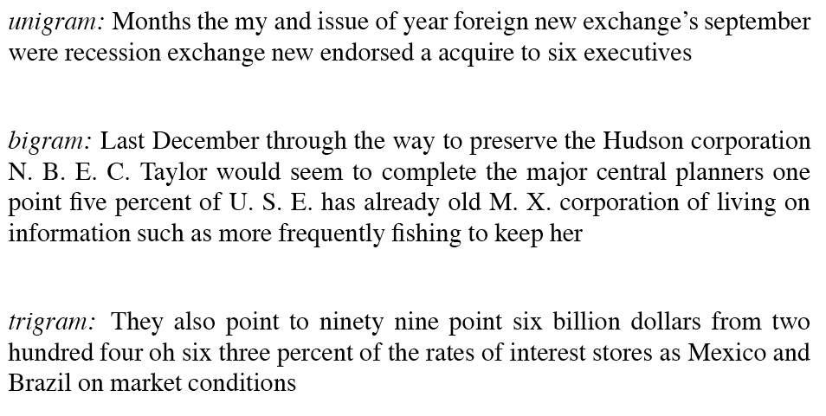
WSJ is not Shakespeare: Sentences Generated from WSJ

Slide 55
Programming Assignment #2
due: 19 February 2018

Slide 56
Now that I freaked you all out
Wednesday:
  Smoothing & Perl
Friday:
  Lancashire & Hirst

